Slide 1
C2.T1_Data Science framework report
DA UT
2021
Created by Jie

Slide 2
Contents
Table of Contents
This report is made up of 4 different parts.
Overview
Description of Data
Analysis Plan
Next Steps

Slide 3
Overview
Abstract of Project
The goal is to build a much better way to improve the credit scoring service.
Client:
Credit One
Background:
The number of customers, who have defaulted on loans they have secured from various partners, has increased.
Credit One as their credit scoring service, need to solve this problem right away.
Final Goals:
To design and implement a creative, empirically sound solution to understand
If someone should be approved or not (at the very least)
How much credit to allow someone to use (if it is possible)

Slide 4
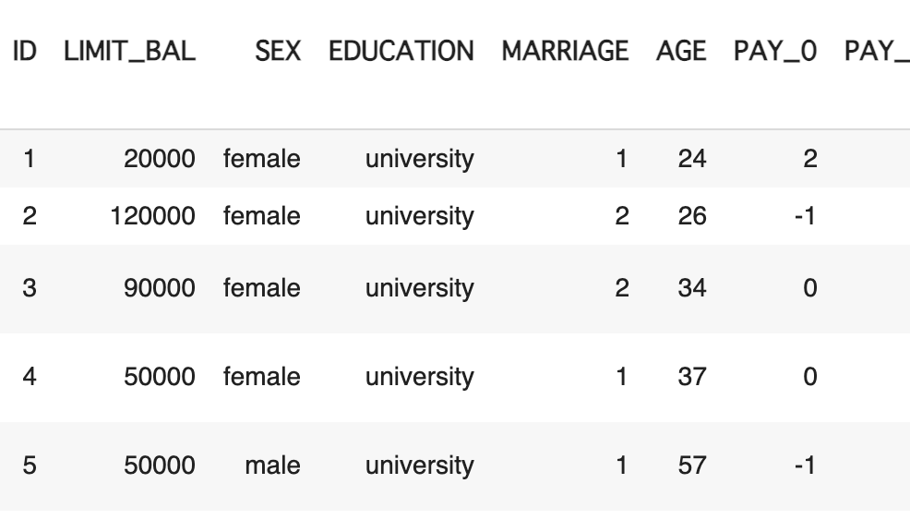
Description of Data
Customers Default Payments Data Set
The dataset consists of 30,000 customers default payments information.
Source:
Credit One
Data Set Information:
The customers default payments information from Apr to Sep, 2005.
Number of Instances: 30,000 (after data cleansing)
Attribute Information:
Total 25 attributes:
‘ID’, ‘LIMIT_BAL’ (amount of the given credit), ‘SEX’, ‘EDUCATION’, ‘MARRIAGE’, ‘AGE’
‘PAY_0’ to ‘PAY_6’ (past monthly payment records)
‘BILL_AMT1’ to ‘BILL_AMT6’ (past monthly amount of bill statement)
‘PAY_AMT1’ to ‘PAY_AMT6’ (past monthly amount of previous payment)
‘default payment next month’ (default or not)
Head of Data Set

Slide 5
Analysis Plan 1 – Process Framework
Process Framework - BADIR
In this data analysis, we’ll use BADIR (Jain and Sharma, Behind Every Good Decision, chapter 4) as our data science process framework.
#
Process
Description
Status
1
Business Question
Find the real and actionable Business question
From
Inquiry
to Insights
DONE
2
Analysis Plan
Formulate a hypothesis-driven Analysis plan
3
Data collection
Collect relevant Data based on the Analysis Plan
4
Insights
Derive Insights using machine learning & statistics
NEXT
5
Recommendation
Drive KPI’s with actionable Recommendation

Slide 6
Analysis Plan 2 – Analysis Plan
Details of Analysis Plan
Here is the detail information about our analysis plan.
#
Process
Topics
Details
2
Analysis Plan
Analysis Goal
Build reliable predictive models for:
If someone will default or not
How much credit to give
Hypotheses
The dependent variable is assumed to be the effected of the other independent variables. Our target variables:
‘default payment next month’
‘LIMIT_BAL’ (amount of the given credit)
Methodology
Linear Regression

Slide 7
Analysis Plan 3 – Project Plan
Details of Project Plan
Here is the timeline and milestones for our project plan.
Now
Until
5/19
Until
5/26
Data Collection
Data Exploration
Training Model
Evaluation
Step 1. Collect the Data
Collect the data from MySQL
Clean the data for future analysis
Step 2. Explore the Data
Explore the data
Show the insights/future recommendations
Step 3. Build/Train Model
Use linear regression to build predictive models
Train the models with training data
Step 4. Evaluate Model
Use trained models to make predictions with test data
Evaluate the performance
Provide a summary report

Slide 8
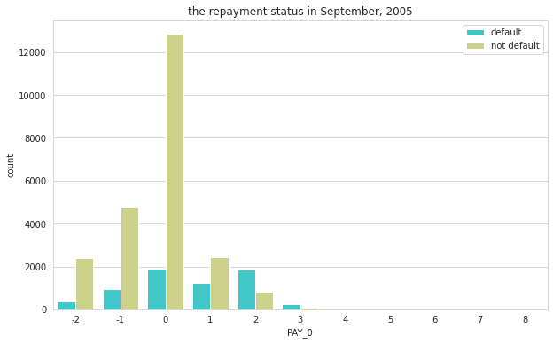
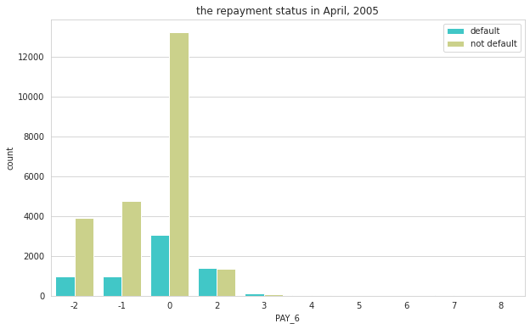
Quick-look of Data
An Increase in ‘payment delay’
It shows an increase in the number of people whose payment is delay.
Explanation:
-2: No consumption; -1: Paid in full; 0: The use of revolving credit;
1 = payment delay for one month; 2 = payment delay for two months; . . .; 8 = payment delay for eight months.
The number of people who’s ‘payment delay’ has increased.

Slide 9
Next Step
Explore the Data and Share the Findings
Here are the actions we will take for the further data analysis.
Next Step:
Exploratory Data Analysis Explore the data and prepare the data for future machine learning.
Share the findings Show the insights and recommendations based on our findings.

Slide 10
Thank you for your attention!
- EOF -

